Slide 1

Webinar 0: Introduction to R for Air Quality Applications
December 2019
Jenny St. Clair, GIS Analyst, MARAMA
Shane Cone, Environmental Scientist, DE DNREC DAQ

Slide 2

Welcome!
Notes:
Jenny and Shane introduce themselves and welcome participants to the training.

Slide 3
Course outline
What makes the R programming language so useful
Some coding basics
Tidyverse—what it can help you with and the idea behind it
Dplyr
Ggplot2
More
A couple non-tidyverse packages
Openair—how this package can help you explore and present monitoring data
Resources for future learning

Slide 4
Participant involvement
Required (necessary for certification):
Pre- and post-test results
Attendance—survey questions
Completion of homework assignments
Practice coding in R independently

Slide 5
Installing R and RStudio
This MUST be completed before webinar 1. Allow time for IT to help you if you do not have admin privileges on your work computer.
This article from Medium tells you everything you need to know about how to install R and RStudio. It includes a video and some brief written instructions:
https://medium.com/@GalarnykMichael/install-r-and-rstudio-on-windows-5f503f708027
If you run into problems please let us know ASAP so that we can help.

Slide 6
Installing packages
The command for installing a package is: install.packages(“packagename”)

Slide 7
FAQ’s about installation

Slide 8
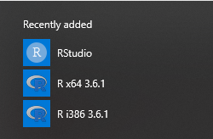
What do these icons do? Why are there two versions of R?
Opens our preferred GUI
64 bit version
Open base R graphic user interface (GUI)
32 bit version

Slide 9
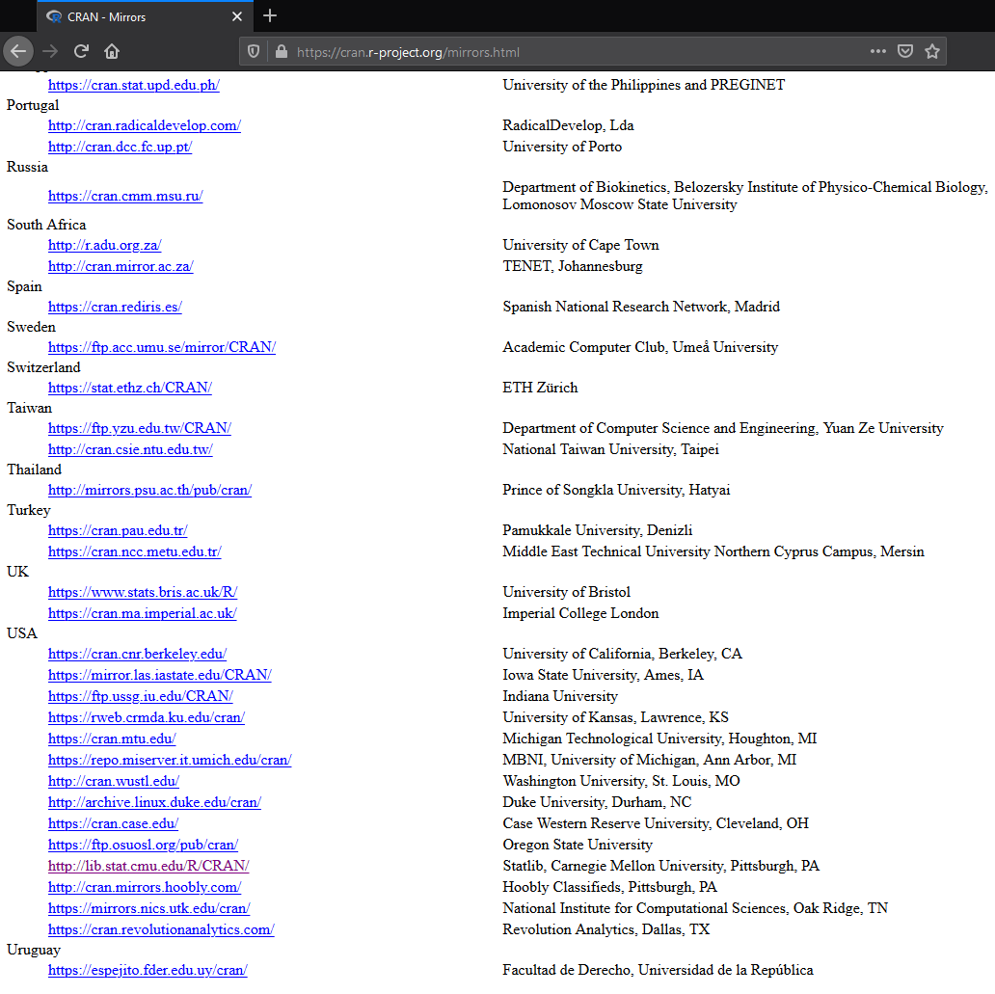
To install R using one of the mirrors provided on the r-project site, choose a location that is somewhat close to you.
Then choose Linux, Mac, or Windows.
Lastly, click “base.”
Mirrors help to control network traffic to improve download speed.

Slide 10

Questions?

